Slide 1
Computational Physics (Lecture 15)
PHY4061

Slide 2
Fourier analysis and orthogonal functions
an arbitrary periodic function f (t),
with a period T ,
can be decomposed into a summation of simple harmonic terms,
which are periodic functions of frequencies
that are multiples of the fundamental frequency 1/T of the function f (t).

Slide 3
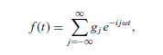
Assuming that we have a time-dependent function f (t) with a period T , that is, f (t + T ) = f (t), the Fourier theorem can be cast as a summation:
ω = 2π/T is the fundamental
angular frequency and g_{j} are the Fourier coefficients

Slide 4
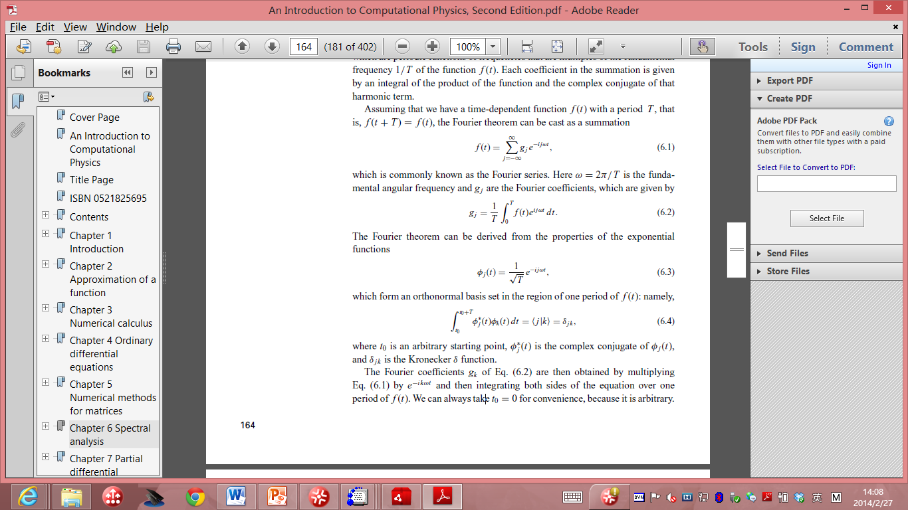
The Fourier theorem can be derived from the properties of the exponential functions:
Which form an orthonormal basis set in the region of one period of f(t):
Where t₀ is an arbitrary starting point,
Φ_{j}*(t) is the complex conjugate of Φ _{j}(t), and δ_{jk} is the Kronecker delta function.

Slide 5
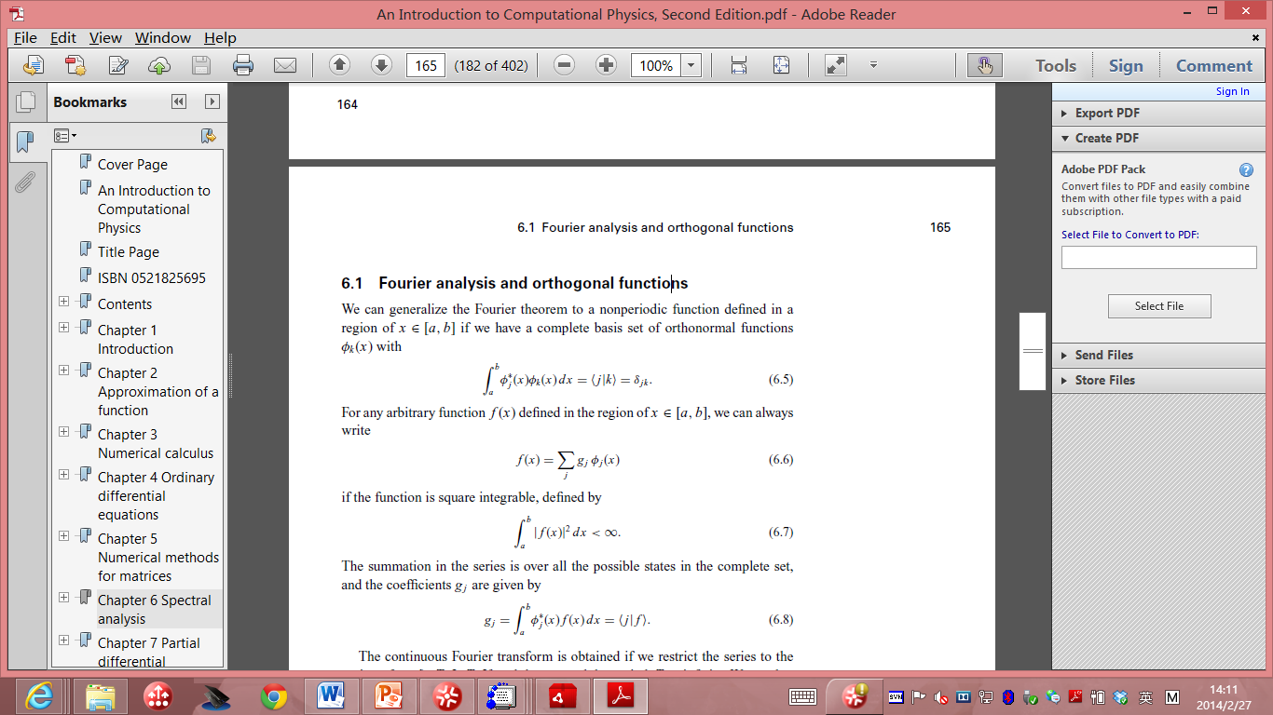
Fourier analysis and orthogonal functions
Fourier theorem to a nonperiodic function in [a, b], suppose we have a complete basis set of orthonormal functions Φ _{k} (x) with:
For any arbitrary function f(x), we have:
If the function is square integrable, defined by:
The summation in the series is over all the possible states in the complete set, and the coefficients g_{j} is given by:

Slide 6
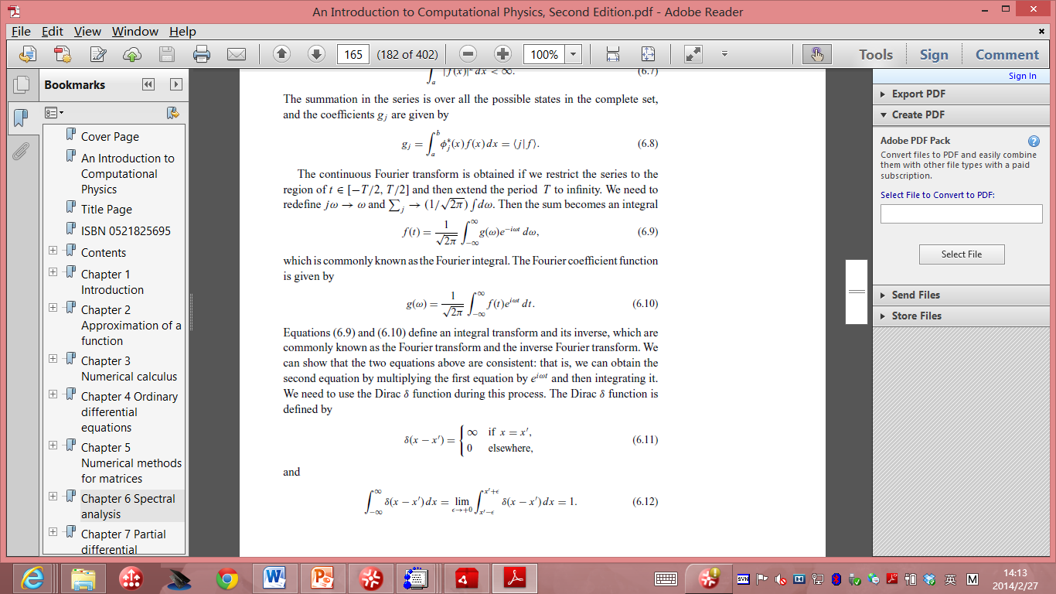
The continuous Fourier transform is obtained if we restrict the series to the region of t from –T/2 to T/2. Then we can extend the period T to infinity. Redefine :
Then the sum becomes:
This is known as the Fourier integral. The Fourier coefficient function is given by:

Slide 7
Discrete Fourier transform
The Fourier transform of a specific function:
usually necessary in the analysis of experimental data,
difficult to establish a clear physical picture just from the raw data taken from an experiment.
Numerical procedures for the Fourier transform:
inevitable in physics and other scientific fields.
We have to deal with a large number of data points,
And the speed of the algorithm for the Fourier transform becomes a very important issue.

Slide 8
We need to convert the continuous variables
into discrete ones before we develop a numerical procedure.
consider f (x) as a space-dependent physical quantity obtained from experimental measurements.
between x = 0 and x = L, f (x) is nonzero only for x ∈ [0, L].

Slide 9
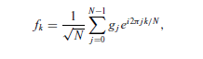
assume that the data are taken at evenly spaced points with each interval h = L/(N − 1),
N is the total number of data points.
assume that the data repeat periodically outside the region of x ∈ [0, L], which is equivalent to imposing the periodic boundary condition on the finite system.
The corresponding wavenumber in the momentum space is then discrete too, with an interval κ = 2π/L.
The discrete Fourier transform:

Slide 10
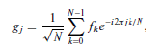
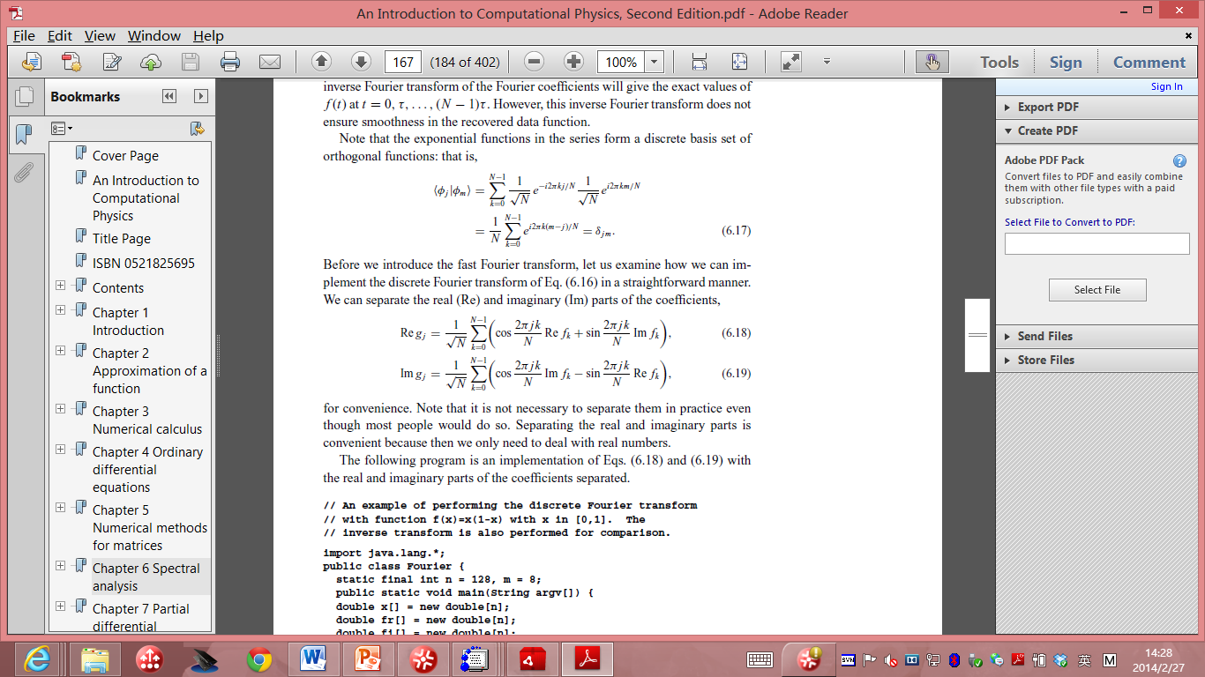
the Fourier coefficients given by
The exponential functions in the series form a discrete basis set of orthogonal functions:
We can implement the discrete Fourier transform in a straightforward manner:

Slide 11
// An example of performing the discrete Fourier transform
// with function f(x)=x(1-x) with x in [0,1]. The
// inverse transform is also performed for comparison.
import java.lang.*;
public class Fourier {
static final int n = 128, m = 8;
public static void main(String argv[]) {
double x[] = new double[n];
double fr[] = new double[n];
double fi[] = new double[n];
double gr[] = new double[n];
double gi[] = new double[n];
double h = 1.0/(n-1);
double f0 = 1/Math.sqrt(n);
// Assign the data and perform the transform
for (int i=0; i<n; ++i) {
x[i] = h*i;
fr[i] = x[i]*(1-x[i]);
fi[i] = 0;
}
dft(fr, fi, gr, gi);
// Perform the inverse Fourier transform
for (int i=0; i<n; ++i) {
gr[i] = f0*gr[i];
gi[i] = -f0*gi[i];
fr[i] = fi[i] = 0;
}
dft(gr, gi, fr, fi);
for (int i=0; i<n; ++i) {
fr[i] = f0*fr[i];
fi[i] = -f0*fi[i];
}
// Output the result in every m data steps
for (int i=0; i<n; i+=m)
System.out.println(x[i] + " " + fr[i] + " " fi[i]);
}

Slide 12
// Method to perform the discrete Foruier transform. Here
// fr[] and fi[] are the real and imaginary parts of the
// data with the correponding outputs gr[] and gi[].
public static void dft(double fr[], double fi[],
double gr[], double gi[]) {
int n = fr.length;
double x = 2*Math.PI/n;
for (int i=0; i<n; ++i) {
for (int j=0; j<n; ++j) {
double q = x*j*i;
gr[i] += fr[j]*Math.cos(q)+fi[j]*Math.sin(q);
gi[i] += fi[j]*Math.cos(q)-fr[j]*Math.sin(q);
}
}
}
}

Slide 13
computing time that is proportional to N²
We can use f (x) = x(1 − x) as the data function to test the method in the region of x ∈ [0, 1].

Slide 14
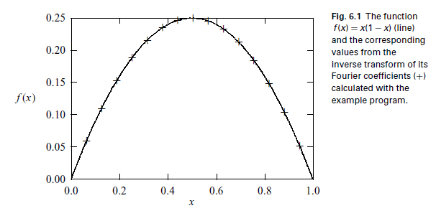

Slide 15
Fast Fourier Transform
The idea behind the fast Fourier transform
even before the first computer was built.
Gauss developed a version of the fast Fourier transform and published his work in neoclassical Latin (Gauss, 1886; Goldstine, 1977, pp. 249–53)
Reinvented by Cooley and Tukey (1965)..

Slide 16
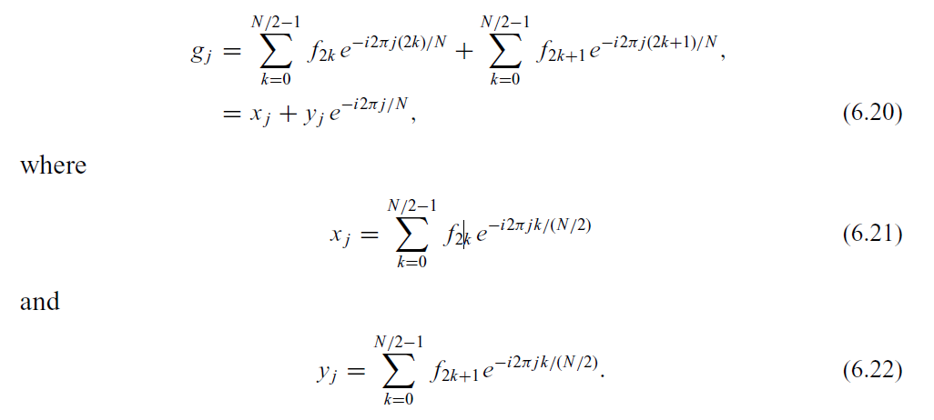
separate the odd and even terms in the discrete Fourier transform as

Slide 17
We rewrite the Fourier transform with a summation of N terms as two summations, each of N/2 terms.
This process can be repeated further and further until eventually we have only two terms in each summation if N = 2^{M},
where M is an integer.

Slide 18
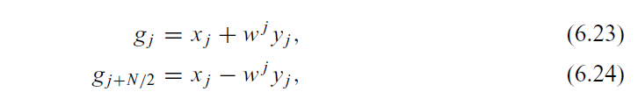
There is one more symmetry between g_{k} for k < N/2 and g_{k} for k ≥ N/2:
w = e^{−i2π/N}
We perform the transform only up to j = N/2 − 1, and the Fourier coefficients with higher j are obtained with the above equation at the same time.

Slide 19
Discretization of the equation
The essence :
discretization of the continuous variables,
the spatial coordinates and time.
Rectangular coordinate system :
discretize ∂ A(r, t)/∂ri ,
∂²A(r, t)/∂ri ∂rj , ∂ A(r, t)/∂t, and ∂²A(r, t)/∂²t, where ri or rj is either x, y, or z.

Slide 20
Sometimes, need to deal with a situation similar to having a spatially dependent diffusion constant
for example, to discretize∇· D(r)∇A(r, t).
Here A(r, t) is a generic function.
We can apply the numerical schemes developed in basic numerical methods part for first-order and second-order derivatives for all the partial derivatives.
we can use the two-point or three-point formula for the first-order partial derivative

Slide 21
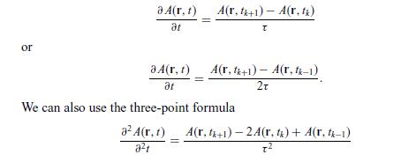
Three point formula
for the second-order derivative. Here t_{k} = t and τ = t_{k+1} − t_{k} = t_{k} − t_{k−1}.

Slide 22
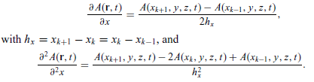
same formulas can be applied to the spatial variables as well, for example
The partial differential equations can then be solved at discrete points.

Slide 23
Above scheme is hard to deal with a discrete mesh that is not uniform or with an inhomogeneity such as ∇· D(r)∇A(r, t),
we may need to introduce some other discretization scheme.
Any rough idea on how to deal with the problem?
We can construct a functional from the field of the solution in an integral form.

Slide 24
The differential equation is recovered from functional variation.
This is in the same spirit as deriving the Lagrange equation from the optimization of the integral.
The advantage here is that we can discretize the integral first and then carry out the functional variation at the lattice points.

Slide 25
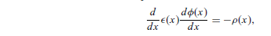

The one-dimensional Poisson equation:
for x ∈ [0, L], as an illustrative example. Here ε(x) is the electric permittivity
that has a spatial dependence.
For simplicity, let us take the boundary condition
φ(0) = φ(L) = 0. We can construct a functional
Leads to the Poisson equation if we take:

Slide 26

If we use the three-point formula for the first-order derivative in the integral and the trapezoid rule to convert the integral into a summation, we have

Slide 27
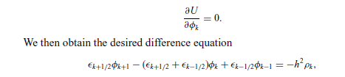
We have used φ_{k} = φ(x_{k} ) for notational convenience and have used ε_{k−1/2} = ε(x_{k−1/2}) as the value of ε(x) in the middle of the interval [x_{k−1}, x_{k} ].
Now if we treat each discrete variable φ_{k} as an independent variable, the functional variation becomes a partial derivative

Slide 28
This scheme is extremely useful when the geometry of the system is not rectangular or when the coefficients in the equation are not constants.
For example, we may want to study the Poisson equation in a cylindrically or spherically symmetric case, or diffusion of some contaminated materials underground where we have a spatially dependent diffusion coefficient.

Slide 29
The stationary one-dimensional diffusion equation is equivalent to the one-dimensional Poisson equation if we replace ε(x) with D(x) and ρ(x) with S(x).
The scheme can also be generalized for the time-dependent diffusion equation.

Slide 30
The matrix method for difference equations
When a partial differential equation is discretized and given in a difference equation form, we can generally solve it with the matrix methods.
In general, when we have a differential equation with the form Lu(r, t) = f (r, t), where L is a linear differential operator of the spatial and time variables, u(r, t) is the physical quantity to be solved, and f (r, t) is the source,
we can always discretize the equation and put it into the matrix form Au = b,

Slide 31
where the coefficient matrix A is from the discretization of the operator L, the column vector u is from the discrete values of u(r, t) excluding the boundary and initial points, and b is the known vector constructed from the discrete values of f (r, t) and the boundary and initial points of u(r, t).
The time variable is usually separated with the Fourier transform first unless it has to be dealt with at different spatial points.

Slide 32
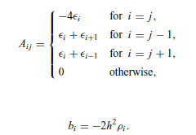
For example, the difference equations for the one-dimensional Poisson equation obtained in the preceding section can be cast into such a form.
This matrix representation of the difference equation resulting from the discretization
of a differential equation is very general.

Slide 33
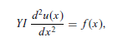
Example: a person is sitting at the middle of a long bench supported at both ends.
Assume that the length of the bench is L.
If we want to know the displacement of the bench at every point, we can establish the equation for the curvature at different locations from Newton’s equation for each tiny slice of the bench.
where u(x) is the curvature (that is, the inverse of the effective radius of the curve
at x), Y is Young’s modulus of the bench, I = t³ w/3 is a geometric constant, with
t being the thickness and w the width of the bench, and f (x) is the force density
on the bench.
Because both ends are fixed, the curvatures there are taken to be
zero: that is, u(0) = u(L) = 0.

Slide 34
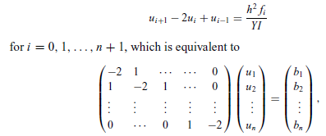
If we discretize the equation with evenly spaced intervals, that is, x₀ = 0, x₁ = h, . . . , x_{n+1} = L, via the three-point formula for the second-order derivative, we have
with u₀ = u_{n+1} = 0, as required by the boundary condition, and bi = h² fi /YI .
We can easily solve the problem with the Gaussian elimination scheme or the
LU decomposition scheme

Slide 35
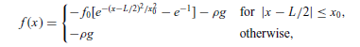
ei = ci = 1 and di = −2. Assume that the force distribution on the bench is given by
with f0 = 200 N/m and x0 = 0.25 m, and that the bench has a length of 3.0 m,
a width of 0.20 m, a thickness of 0.030 m, a linear density of ρ = 3.0 kg/m, and
a Young’s modulus of 1.0 × 10⁹ N/m2. Here g = 9.80 m/s² is the magnitude of the gravitational acceleration

Slide 36
// A program to solve the problem of a person sitting
// on a bench as described in the text.
import java.lang.*;
public class Bench {
final static int n = 99, m = 2;
public static void main(String argv[]) {
double d[] = new double[n];
double b[] = new double[n];
double c[] = new double[n];
double l = 3, l2 = l/2, h = l/(n+1), h2 = h*h;
double x0 = 0.25, x2 = x0*x0, e0 = 1/Math.E;
double rho = 3, g = 9.8, f0 = 200;
double y = 1e9*Math.pow(0.03,3)*0.2/3;
// Evaluate the coefficient matrix elements
for (int i=0; i<n; ++i) {
d[i] = -2;
c[i] = 1;
b[i] = -rho*g;
double x = h*(i+1)-l2;
if (Math.abs(x) < x0)
b[i] -= f0*(Math.exp(-x*x/x2)-e0);
b[i] *= h2/y;
}
// Obtain the solution of the curverture of the bench
double u[] = tridiagonalLinearEq(d, c, c, b);
// Output the result in every m time steps
double x = h;
double mh = m*h;
for (int i=0; i<n; i+=m) {
System.out.println(x + " " + 100*u[i]);
x += mh;
}
}
// Method to solve the tridiagonal linear equation set.
public static double[] tridiagonalLinearEq(double d[],
double e[], double c[], double b[]) {...}
}

Slide 37
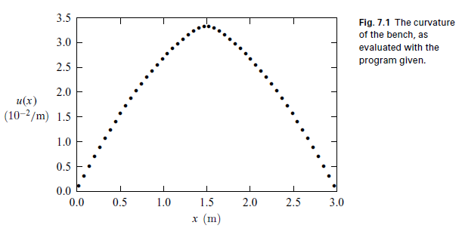
The numerical result for the curvature of the bench calculated with the above
program is illustrated here. Under these realistic parameters, the bench
does not deviate from the original position very much. Even at the middle of the
bench, the effective radius for the curve is still about 30 m.

Slide 38
When the equation is discretized into a difference equation, it becomes extremely simple with a symmetric, tridiagonal coefficient matrix.
In general, all one-dimensional problems with the same mathematical structure can be solved in the same fashion, such as the one-dimensional Poisson equation or the stationary one-dimensional diffusion equation.

Slide 39
If we split the coefficient matrix among the coordinates correctly, we can still preserve its tridiagonal nature, at least, in each step along each coordinate direction.
As long as the coefficient matrix is tridiagonal, we can use the simple LU decomposition to obtain the solution of the linear equation set.
Sometimes we may also need to solve the linear problem with the full matrix that is no longer tridiagonal. We can just apply the methods we learned in the matrix chapter to solve them.
Such as household algorithm.

